Slide 1
The Effects of Pollution on Aquatic Life
By Abbie Jones

Slide 2
Why should we care?
The ocean holds up to 97% of the water on Earth
50% to 70% of the oxygen produced is from the
ocean.
It regulates our climates.
93% of the carbon dioxide is absorbed by the ocean.
It is the home to billions of species of aquatic life.
Without, there is no us.

Slide 3
Purpose:
I am constructing an experiment that will discover how pollutants of varying concentrations harm aquatic life. This data and information will help determine which of these pollutants cause the most damage to aquatic life and this data will hopefully educate people on how important it is to care for our water.

Slide 4
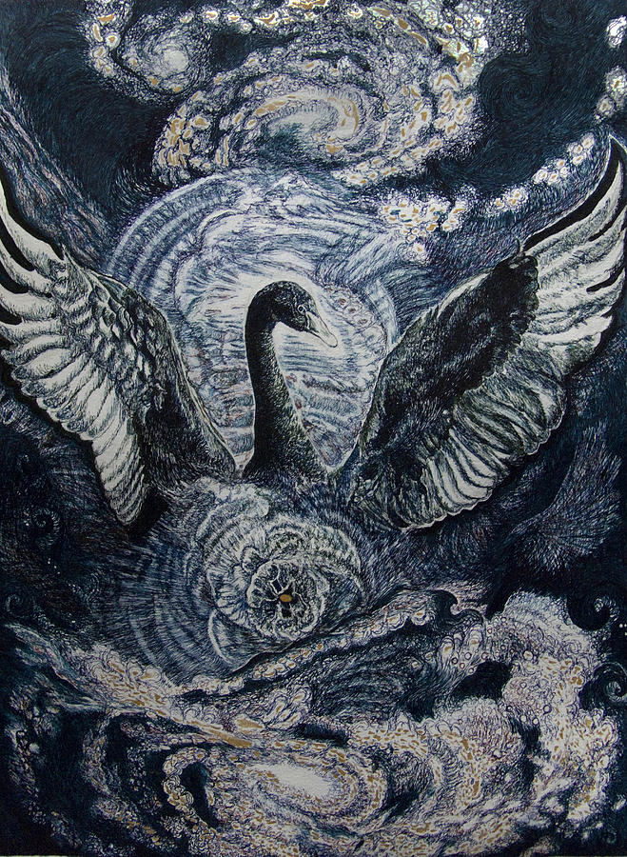
Hypothesis:
The four main pollutants being tested are; milk, lignin sulfonate, antifreeze, and oil. They will all be tested on daphnia pulex. My hypothesis is that the most harmful pollutants will prove to be antifreeze and motor oil.

Slide 5
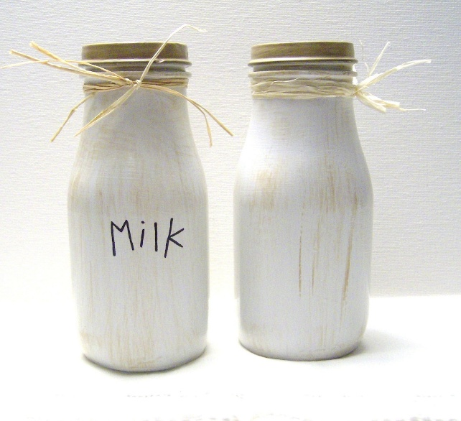
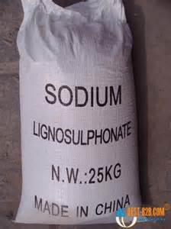
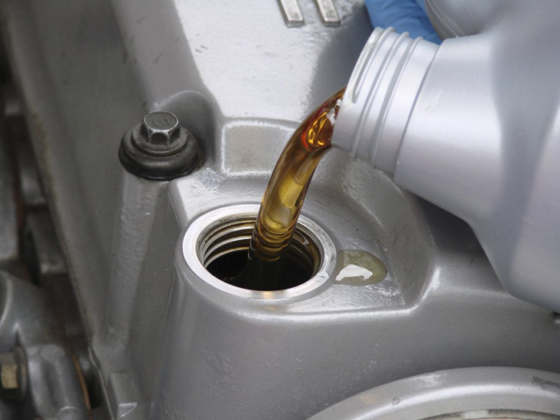
Materials:
7) 16 liters of ultra-pure water
8) 1.536g of NaHCO3 ( Sodium Bcarbonate)
9) 0.96g of CaSO4.2H2O ( Hydrated Calcium Sulfate)
10) 0.96g of MgSO4 ( Magnesium Sulfate)
11) 0.064g of KCI ( Potassium Chloride)
12) 1200 Neonate daphniapulex 13) 500ml of distilled water
15) 6.3 grams of finely ground trout chow
16) .6 grams of dried yeast
17) .5 grams of dried alfalfa
19) 293.50ml of milk
20) 221.50ml of antifreeze
21) 197.50ml of motor oil
22) 197.50ml of lignin sulfonate

Slide 6
Procedures:
Acute Test #1
Acute Test #2
Chronic Test

Slide 7
Acute Test #1
1. Clean out six beta cups and lids. 2. Punch a hole in each lid for the air hose. 3. Cut four 25cm lengths of air hose to run from the beta cup to a valve on gang valve. 4. Cut a seven-centimeter length of hose to attach from one valve on the gang valve to a T-valve. Then cut two more seven-cm lengths to attach to each side of the T-valve. These lengths will be used for beta cups. 5. Attach a Discard-A-Stone air diffuser with an airline nipple to one end of each hose. 6. Insert the other end of the hose through the hole in the lid. 7. Attach all the hoses to the gang valve. 8. To attach the gang valve to the air pump, cut a seven-cm length of hose to attach to the pump and the gang valve. 9. Add each concentration, in percent by volume, of pollutant: 50%, 20%, 10%, 5%, and 1%. Control is 100mL of ultra-pure water. 10. Add the remaining amount of milliliters of water to each cup to equal 100mL. 11. Repeat steps 1-10 to create a replicate of the test for cross-referencing.

Slide 8
12. Using the eyedropper, remove 120 neonate daphnia pulex from the breeding tank and place ten in each cup. 13. Place the air diffuser flat on the bottom of the beta cup and replace the lid. 14. Plug in the air pump, and using the adjusting switches on the gang valve, regulate the airflow in each beta cup. 15. To count the daphnia: a) After 24 hours, remove one concentration cup at a time from the gang valve. b) Gently pour one solution onto the white plate. This helps in viewing the daphnia. c) Using the eyedropper, remove all living daphnia that are visible. Place and count them in the bowl of a white plastic spoon. d) Rotate the plate and watch for any other movement. e) If after a few minutes you see no more live daphnia, put the solution back in the beta cup and re-add the daphnia. f) Record the number of live daphnia and any comments. Repeat steps a-e for all test concentrations. g) Reattach the hose to the same position on the gang valve. 16. After 48 hours repeat step 15 to count the daphnia. This ends the acute test. 17. Repeat steps 1-16 for all four of the pollutants. Use fresh materials for each of the pollutants.

Slide 9
Acute Test #2
After running all four pollutants in the first acute test, and discovering that they were extremely lethal, I decided to lower the concentrations and re-run the acute tests. I will use the following concentrations in percent by volume:
* Milk - 20%, 15%, 10%, 5%, 1% and control. * Antifreeze - 5%, 4%, 3%, 2%, 1%, and control. * Lignin sulfonate - 1%, 0.5%, 0.3%, 0.2%, 0.1%, and control. * Motor oil - 1%, 0.5%, 0.3%, 0.2%, 0.1%, and control.

Slide 10
Chronic Test
1. Clean out six beta cups and lids. 2. Punch a hole in each lid for the air hose. 3. Cut four 25cm lengths of air hose to run from the beta cup to a valve on gang valve. 4. Cut a seven-centimeter length of hose to attach from one valve on the gang valve to a T-valve. Then cut two more seven-cm lengths to attach to each side of the T-valve. These lengths will be used for beta cups. 5. Attach a Discard-A-Stone air diffuser with an airline nipple to one end of each hose. 6. Insert the other end of the hose through the hole in the lid. 7. Attach all the hoses to the gang valve. 8. To attach the gang valve to the air pump, cut a seven-cm length of hose to attach to the pump and the gang valve. 9. Based on the results of the acute tests, I will use the following concentrations, in percent by volume, for each pollutant:
* Milk - 5%, 3%, 1%, 0.5%, 0.25%, and control. * Antifreeze - 5%, 3%, 1%, 0.5%, 0.25%, and control. * Lignin sulfonate - 0.25%, 0.2%, 0.15%, 0.1%, 0.05% and control * Motor oil - 0.1%, 0.08%, 0.06%, 0.04%, 0.02%, and control.
`

Slide 11
10. Add the remaining amount of milliliters of water to each cup to equal 100mL. 11. Repeat steps 1-10 to create a replicate of the test for cross-referencing. 12. Using the eyedropper, remove 120 neonate daphnia pulex from the breeding tank and place ten in each cup. 13. Place the air diffuser flat on the bottom of the beta cup and replace the lid. 14. Plug in the air pump, and using the adjusting switches on the gang valve, regulate the airflow in each beta cups. 15. To count the daphnia: a) After seven days, remove one concentration cup at a time from the gang valve. b) Gently pour one test solution onto the white plate. This helps in viewing the daphnia. c) Using the eyedropper, remove all living daphnia that are visible. Place and count them into the bowl of a white plastic spoon. d) Rotate the plate and watch for any other movement. e) Record the number of live daphnia and any comments. Repeat steps a-e for all concentrations and controls of both sets of pollutant. 16. Repeat steps 1-15 for all four of the pollutants. Use fresh materials for each of the pollutants.

Slide 12
Results:
The results show that the varying pollutants did indeed have a negative impact effect on the daphnia pulex. The most lethal pollutant proved to be oil. The oil was so toxic that the concentration was difficult to get low enough. The lowest concentration, 0.02 ml of oil in 100ml of water, is equivalent to 200 liters of oil in one million liters of water. In the acute test, antifreeze was more lethal than milk, but in the chronic test it was less. The results also show that even at low concentrations of lignin sulfonate, it is lethal over a long period of time.

Slide 13
Conclusion:
The results indicate that my original hypothesis should be partially accepted and rejected. I was correct that the highest concentrations of pollutants would be the most lethal. I was incorrect that it would be motor oil and antifreeze. In fact, it showed that motor oil and lignin sulfate were the most lethal pollutants. Antifreeze proved to be the least toxic pollutant.

