Slide 1
A Review of Biogas as an Alternative Energy Source for Synthetic Natural Gas Technology
Lucas Bautista
Antioch College
June 21, 2017

Slide 2
Introduction
Organic waste such as farm runoff, human waste and animal waste are increasing problems in many societies
This waste can be used to produce a clean gas as well as a liquid fertilizer, which is a byproduct of producing the clean gas
The produced gas can be used as is or can be modified through a variety of processes to create a synthetic natural gas (SNG) which can be used in existing pipelines

Slide 3
Biomass to Biogas
Dry biomass like crops and wood chips are burned to create biogas
Wet biomass like sewage, human waste, and animal waste are broken down by bacteria in an environment lacking oxygen known as anaerobic digestion in order to produce biogas
This process is known as gasification

Slide 4
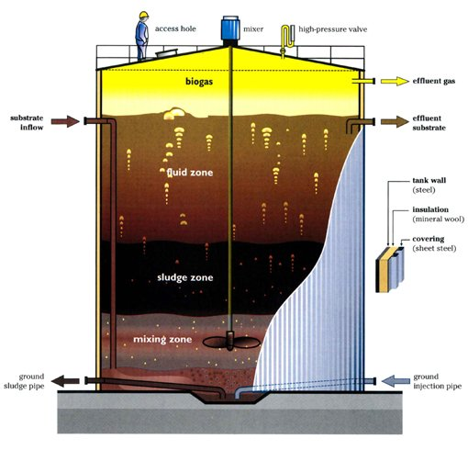

Slide 6
Biogas to SNG
The process of turning biogas into synthetic natural gas is complex
It can be done a number of ways using various techniques and technologies

Slide 7
Techniques
Fixed bed methanation - removes small amounts of CO with reactors
Lurgi process - methanation unit with two fixed bed reactors
Fluidized bed methanation - large scale, highly exothermic, heterogeneously catalyzed reactions that are practically isothermal

Slide 8
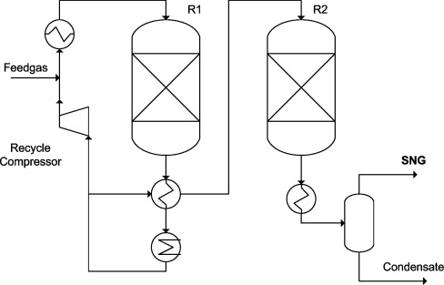
Lurgi process diagram

Slide 9
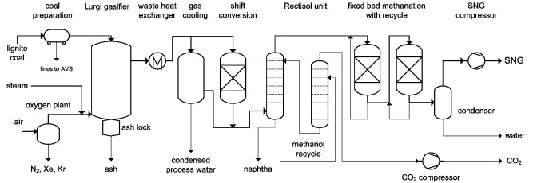
Great Plains Synfuels Plant (North Dakota) 2009

Slide 10
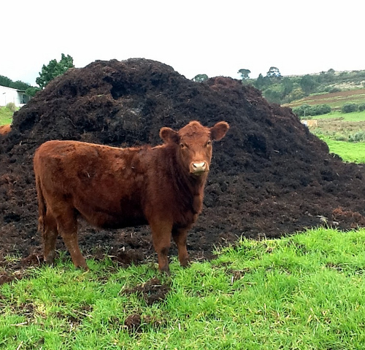
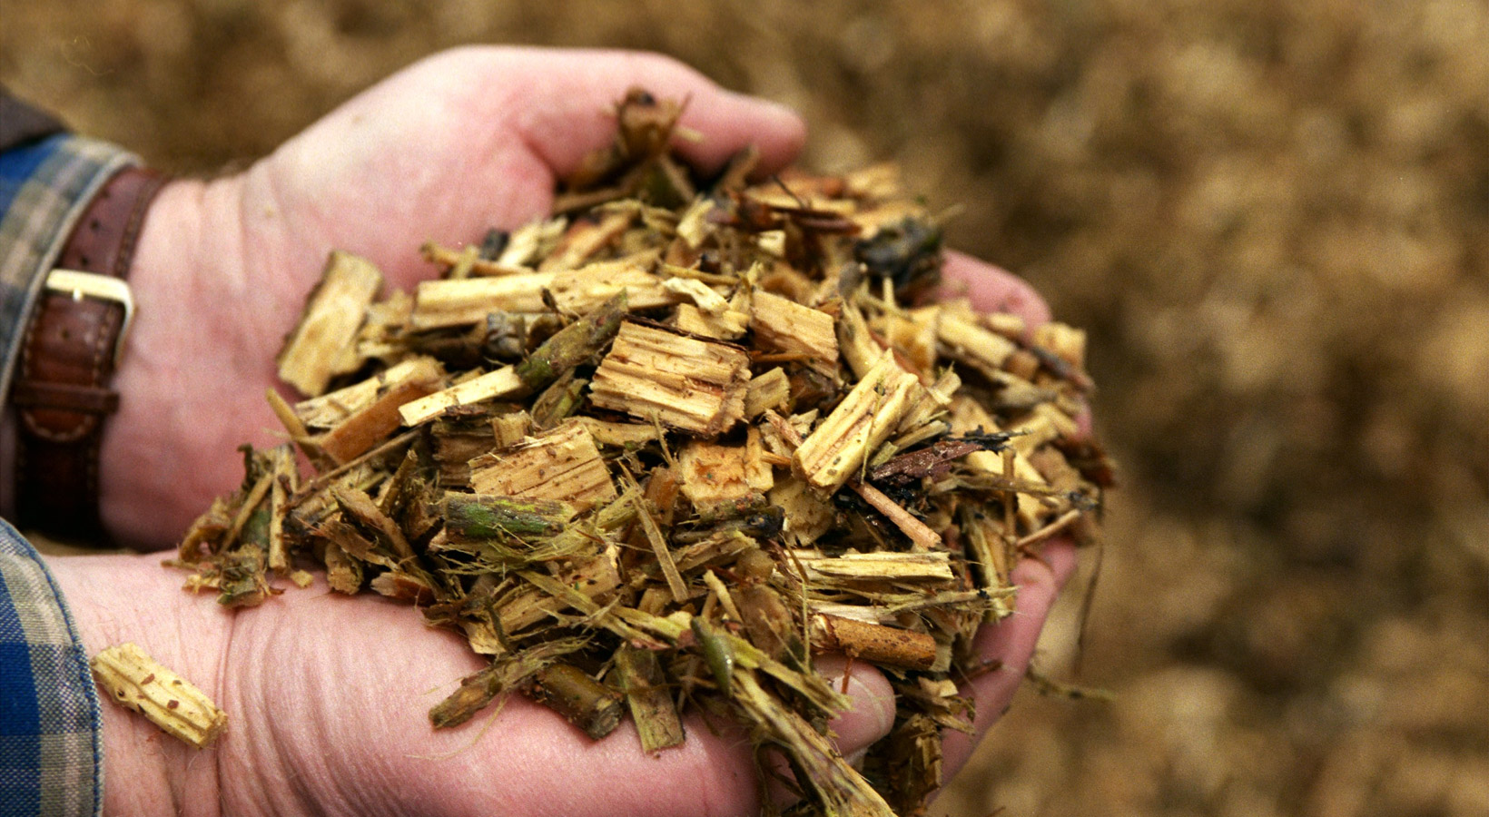
Efficiency
Coal and solid biomass have a chemical efficiency of up to 65%
Wet biomass has a low chemical efficiency of 20-40%
In 2017 an electrical efficiency of 29% was achieved in a plant using dual fluidized beds though there were ways to raise the efficiency to 31%

Slide 11
Significance of Study
Details SNG availability, extraction technologies, and use as a renewable resource
Transported using existing natural gas infrastructure and able to be incorporated with natural gas that is already in the pipelines
Helps eliminate waste whether it is dry or wet/liquid
Carbon sequestration

Slide 12
References:
Colleta P., Flottesc E., Favrea A., Raynala L., Pierrec H., Capelac S., and Peregrinad C. 2017. Techno-economic and Life Cycle
Assessment of methane production via biogas upgrading and power to gas technology. Applied Energy. 192:282-295.
Hervas-Blasco E., Pitarch M., Navaro-Peris E., and Corberán J. 2017. Optimal sizing of a heat pump booster for sanitary hot water
production to maximize benefit for the substitution of gas boilers. Energy. 127:558-570.
Kopyscinski J., Schildhauer T., and Biollaz S. 2010. Production of synthetic natural gas (SNG) from coal and dry biomass – A
technology review from 1950 to 2009. Fuel. 89(8):1763-1783
Kraussler, M., Schidler P., and Hofbauer H. 2017. An experimental approach aiming the production of a gas mixture composed of
hydrogen and methane from biomass as natural gas substitute in industrial applications. Bioresource Technology. https://doi.org/10.1016/j.biortech.2017.03.040
Mesfuna S., Sanchezc D., Leducb S., Wetterlunda E., Lundgrena J., Biberacherd M., and Kraxnerb F. 2017. Power-to-gas and
power-to-liquid for managing renewable electricity intermittency in the Alpine Region. Renewable Energy. 107:361-372.
Nizami A., Shahzad K., Rehan M., Ouda O., Khan M,. Ismail I., Almeelbi T., Basahi J., and Demirbas A. 2017. Developing waste
biorefinery in Makkah: A way forward to convert urban waste into renewable energy. Applied Energy. 186(2):189-196.
Noyola A., Morgan-Sagastume J., and López-Hernández J. 2006. Treatment of Biogas Produced in Anaerobic Reactors for Domestic
Wastewater: Odor Control and Energy/Resource Recovery. Rev Environ Sci Biotechnol. 5(1):93-114.
Rehling B., Hofbauer H., Rauch R., and Aichernig C. 2011. BioSNG—process simulation and comparison with first results from a 1-MW
demonstration plant. Biomass Conv. Bioref. 1(2:)111-119.
Roy S., and Das D. 2016. Biohythane production from organic wastes: present state of art. Environ Sci Pollut Res. 23(10):9391-9410.
Tsapekos P., Kouglas P., Treu L., Campanero S., and Angelidaki I. 2017. Process performance and comparative metagenomic analysis
during co-digestion of manure and lignocellulosic biomass for biogas production. Applied Energy. 185(1):126-135.
Wilk V., and Hofbauer H. 2016. Analysis of optimization potential in commercial biomass gasification plants using process simulation.
Fuel Processing Technology. 141(1)138-147.

