Slide 1
The Biopsychology of Sleep and Dreaming
By Julia Dwight

Slide 2
The Sleep Cycle When does dreaming occur?
EEG
Electroencephalographic (EEG): is the electrophysiological monitoring
method that records neural oscillations.

Slide 3
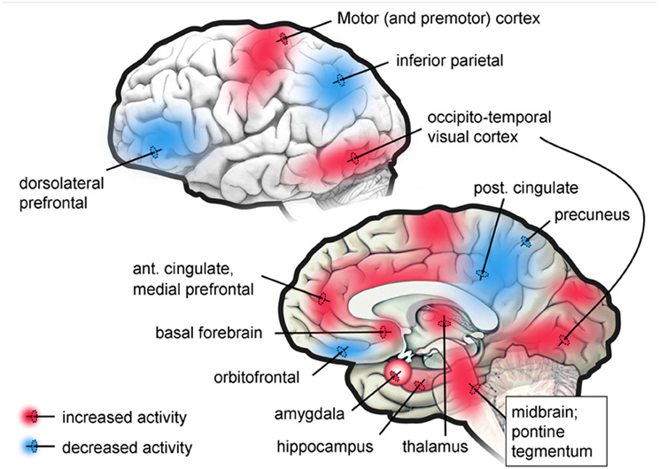

Slide 4
Comparison of brain activity in patients: while awake, lucid dreaming and during REM sleep
Activated
Deactivated
REM sleep: Rapid eye movement sleep, usually occurring in approximately 90-minute cycles.

Slide 5
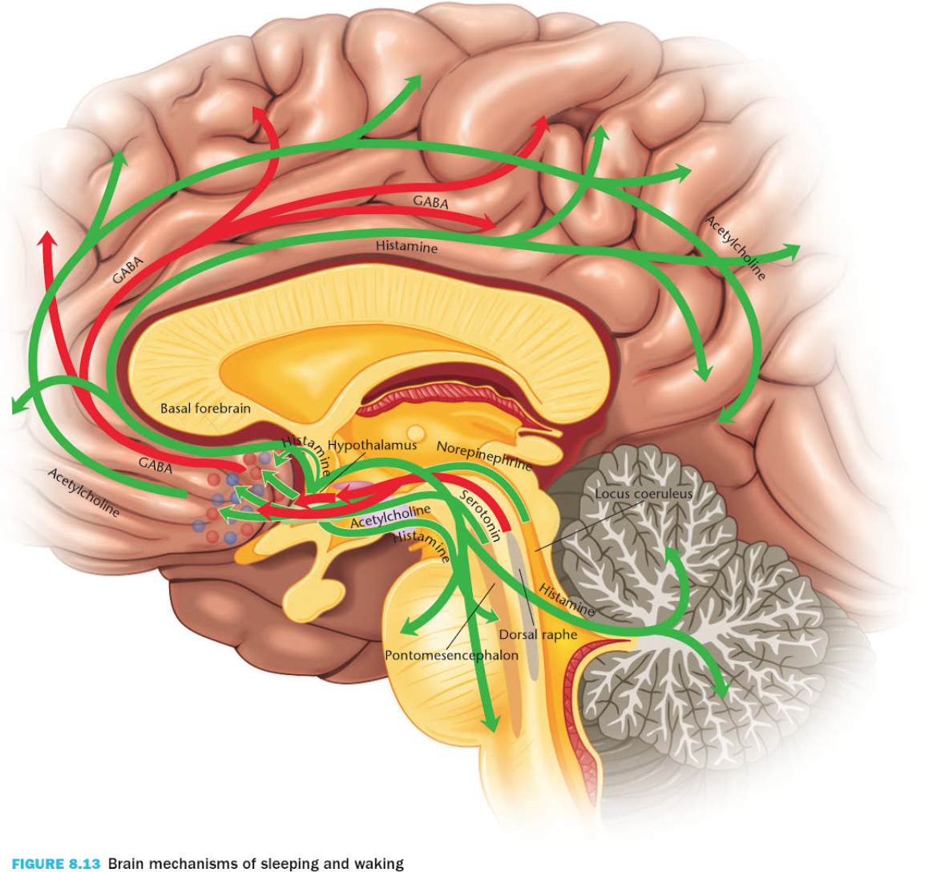
Inhibitory
Excitatory

Slide 6
Conclusions

Slide 7
Sources
Desseilles, M., T. Dang-Vu, V. Sterpenich, and S. Schwartz. "Cognitive and Emotional Processes during Dreaming: A Neuroimaging View." Consciousness and Cognition. U.S. National Library of Medicine, 2010. Web. 10 Mar. 2017.
Kalat, James W. Biological Psychology. 12th ed. N.p.: Thomson/Brooks/Cole, 2016. Print.
Linden, Sander Van Der. "The Science Behind Dreaming." Scientific American. Nature America INC., 25 July 2011. Web. 10 Mar. 2017.
Klus, Helen. "What Happens to Us When We Dream?" The Star Garden. N.p., 17 Nov. 2013. Web. 10 Mar. 2017.
Hurd, Ryan, Hugh Harrison Says, Eric Wargo Says, Ryan Hurd Says, Robert Rider Says, Christina Says, A. Muhammad Ma`ruf Says, Danielle Says, S. Nau Says, Martín Bidegain Says, and Ben Says. "Dream Studies Press." Dream Studies Portal. Dream Studies, 2010 0. Web. 10 Mar. 2017.
Crabtree, Vexen. "The Biology of Dreaming." Www.humantruth.info. N.p., 2005. Web. 10 Mar. 2017.

Slide 8
Questions?

