Slide 1
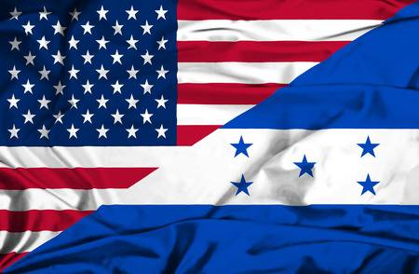
A History of the United States & Honduras Relations
Kensy Zelaya

Slide 2
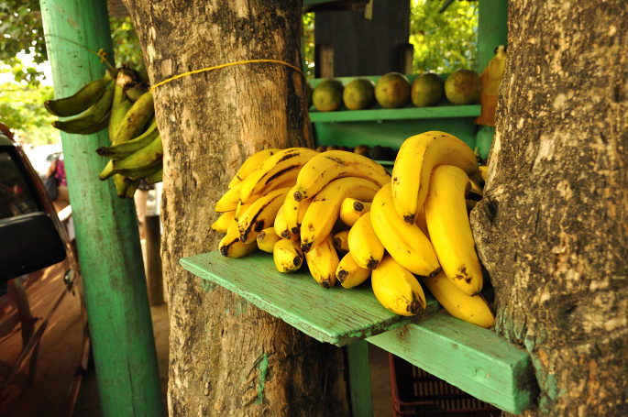
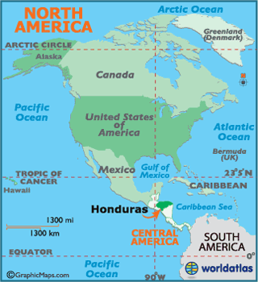
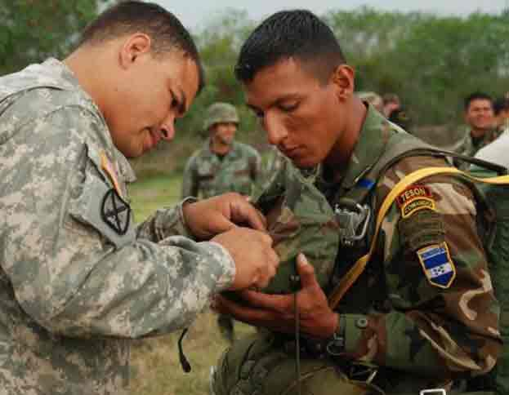
United States and Honduras? Why ?
Agriculture: banana farming
Mining: gold and silver
Military Service
Geographical location

Slide 3
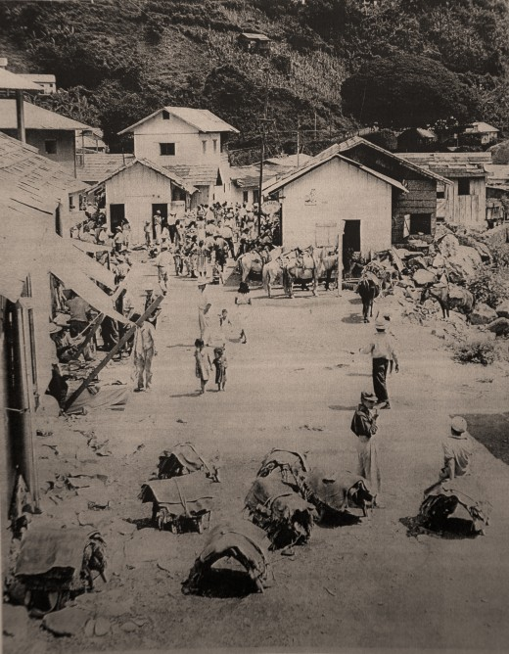
United States Presence in Honduras through time
The American Civil War
Request of immigration by Colonel Green in 1867.
Marco Soto owned the mining rights from the mines in El Rosario, Honduras.
Exemption of taxes
Julius Valentine from New York founded ¨New York and Honduras Rosario Mining Company¨.
Pack trains loading and unloading freight.

Slide 4
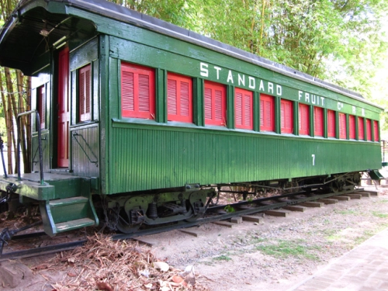
During the 20th Century...
North Americans presence in the banana and mining industries.
The Rosario Mining Company
United Fruit Company
The Standard Fruit Company
American Banana Business had the best land
Bribery by The United Fruit Company
In the 1980’s, Ronald Reagan send military troops.

Slide 5
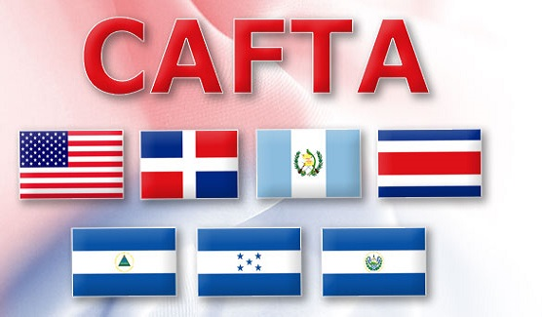
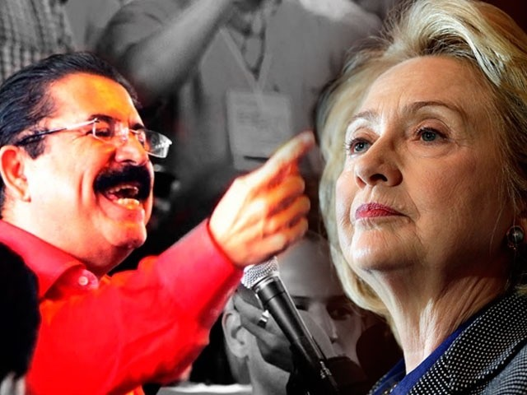
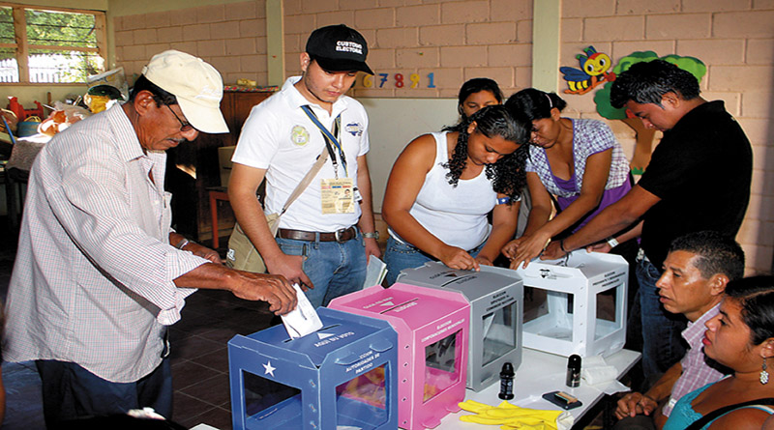
In 2005 Honduras enters CAFTA
In 2009, president Manuel Zelaya was exiled in a military coup.
In 2017, Honduras had an electoral crisis

Slide 6
What about the electoral crisis in Honduras in 2017?
Honduras receives millions of dollars from The United States
The Honduran military elite receive training from United States.
The Trump administration have an excellent relation with president Hernandez.
JTF-Bravo partners with Honduran military to bring humanitarian aid to locals

Slide 7
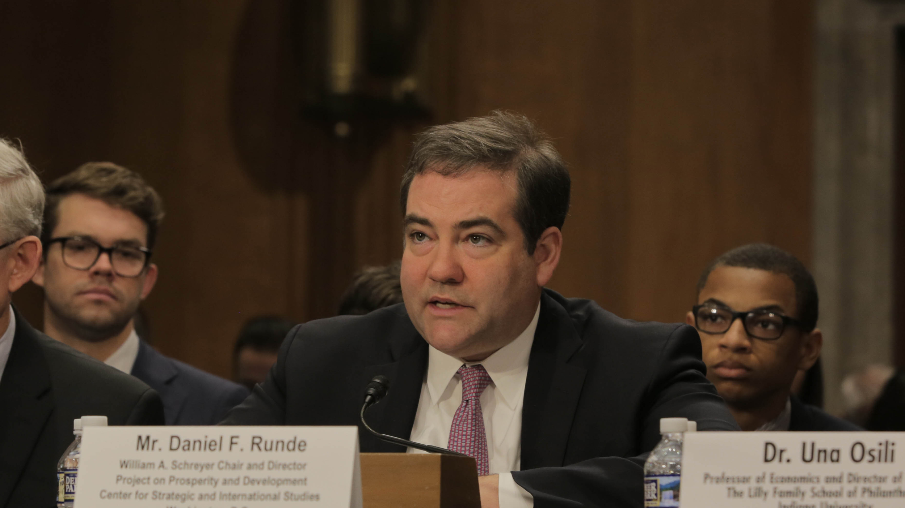
¨Washington has invested significant money in Central America to help turn the security and economic situation around. If Hernandez loses the election, the United States will have no effective partners in the region, the effectiveness of our billions of dollars would be at risk¨ added Daniel Runde, republican foreign policy advisor.

Slide 8
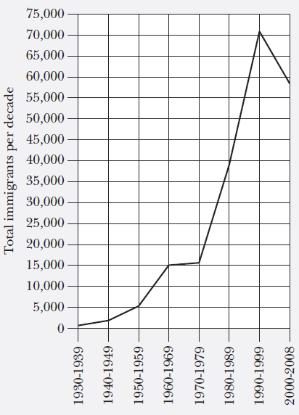
Honduran presence in the United States
Before the 1950´s , very small presence
By 1999, more than 7,100 immigrants were coming per year.
The Temporary Protected Status (TPS) in 1998
By 2008, nearly one million of Hondurans lived in United States.

Slide 9
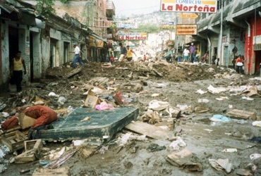
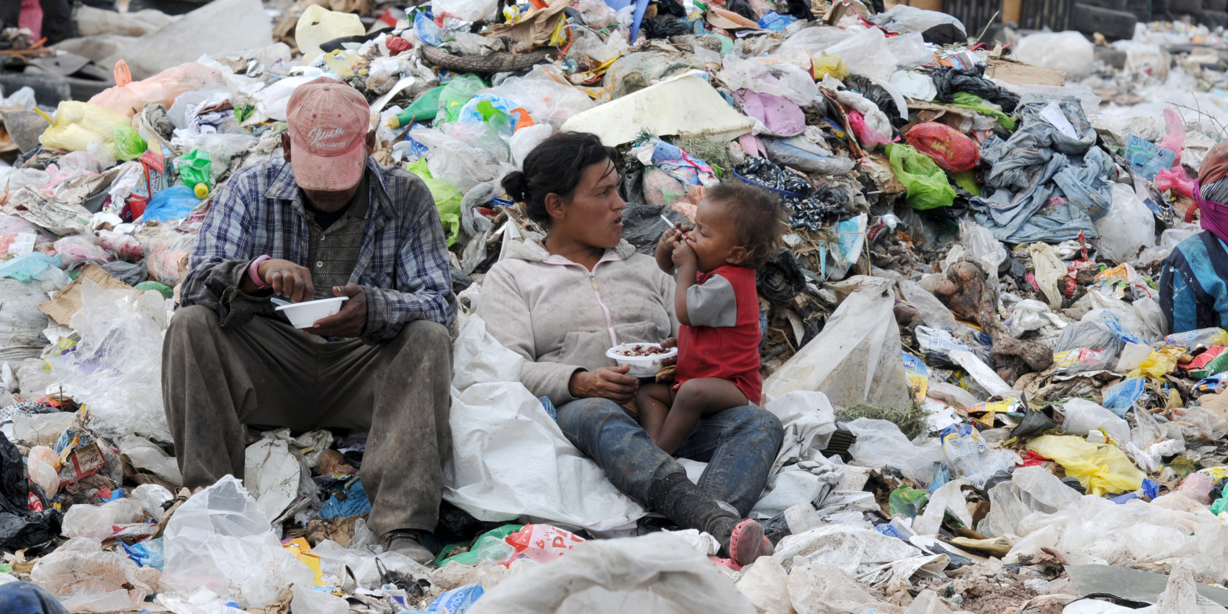
Why do Hondurans migrate to United States?
Through time hondurans have migrated because of:
Economic problems: Poverty
Natural disasters: Hurricane Mitch
Hurricane Mitch 1998 in Honduras
Poverty in Honduras

Slide 10
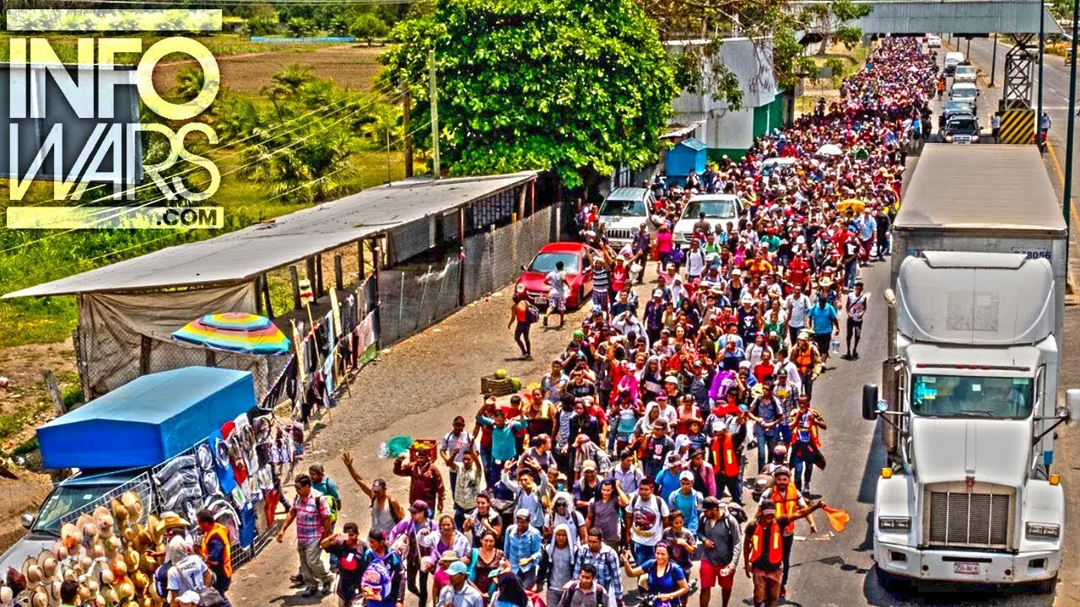
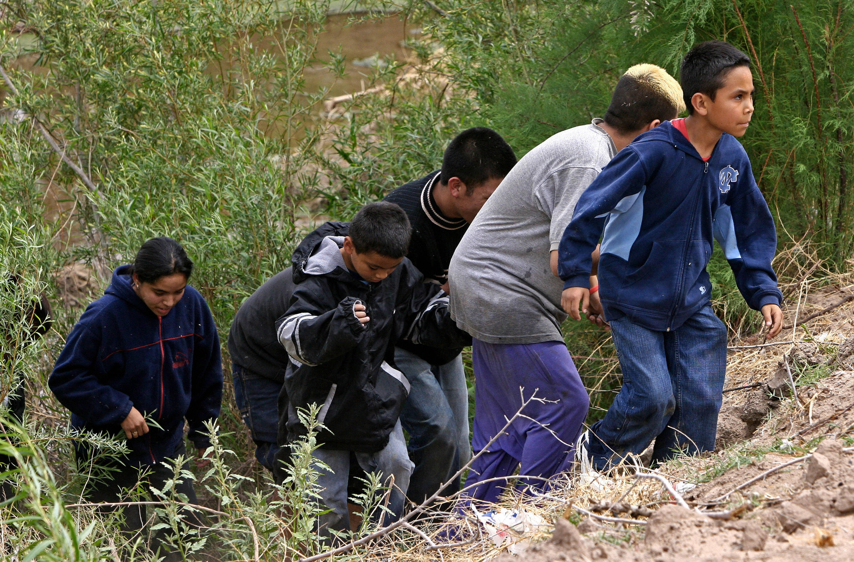
Hondurans face many hardships trying to cross to United States
Expose themselves to rape, heat, robbery and murder
https://www.youtube.com/watch?v=OkkQuDUzgbE
Often hire ¨coyotes¨ to cross to the other side.

Slide 11
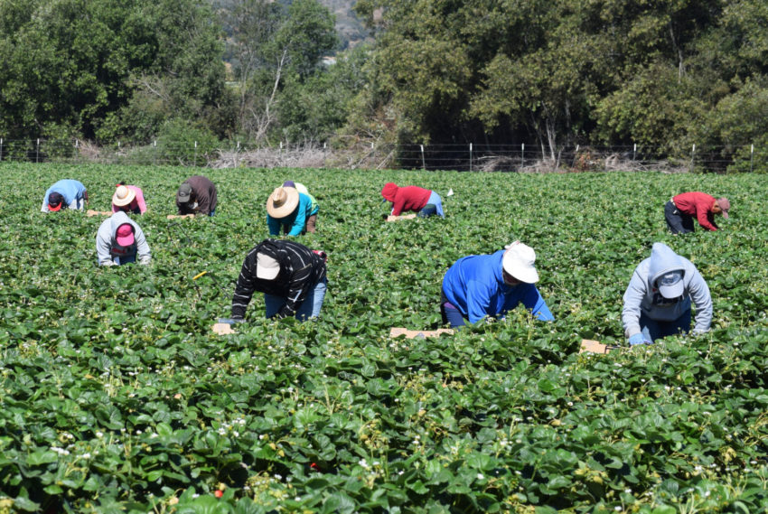
When Hondurans enter to United States they...
Work and send remittances to families.
Honduras economic system is positively impacted by these remittances.
They save money and sometimes go back to Honduras and establish over there.

Slide 12
Sources
http://immigrationtounitedstates.org/555-honduran-immigrants.html (Immigration to the United States)
https://www.washingtonpost.com/news/worldviews/wp/2017/12/04/the-crisis-in-honduras-should-matter-to-the-u-s/?noredirect=on&utm_term=.d958891f6fac (Washington Post)

Slide 13
Thank you !

