Slide 1
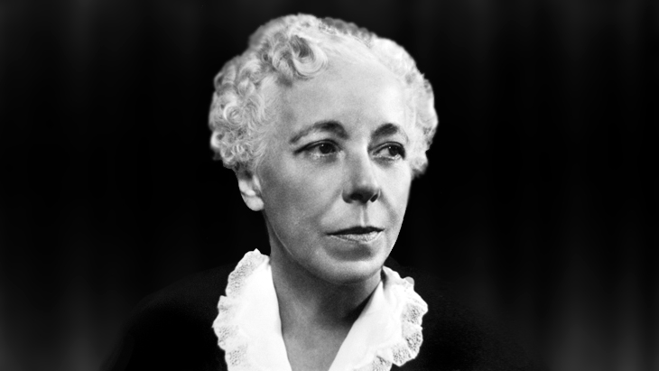
Karen Horney: Feminine Psychology
By: Kensy Zelaya
PSYCH 230

Slide 2
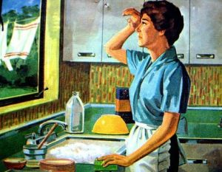
What is Feminine Psychology ?
A revision of psychology that show the psychological conflicts in the traditional women roles

Slide 3
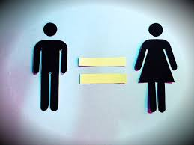
What did Karen Horney did?
Changed the way psychologists view women
Men and women are not born with different personalities
The factors that determine the differences are : Society and Culture
She died before the feminist movement, but her ideas were used to promote equality

Slide 4
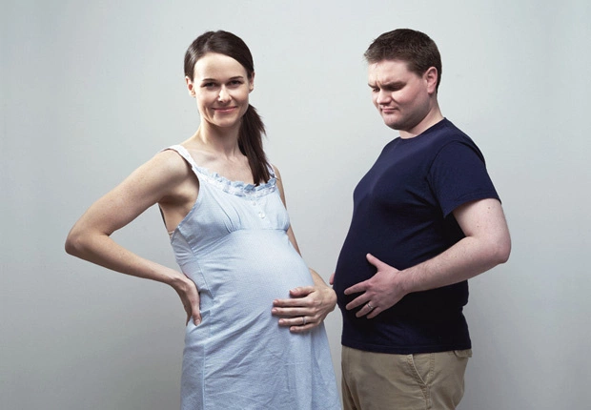
Penis Envy v. Womb Envy
She believed that men compensated the inability of having babies with other achievements.
Penis envy is a result of gender power that society give to men.
Women envy the privilege and power that men have.

Slide 5
Examples of Feminine Psychology TODAY
Ain’t your Mama by Jennifer Lopez
https://www.youtube.com/watch?v=Pgmx7z49OEk
Run the World (Girls) by Beyoncé
https://www.youtube.com/watch?v=VBmMU_iwe6U

